Slide 1

Tableau Workshop
July 31, 2019 – Addis Ababa University

Slide 2


Slide 3

QED Group brings
more than 20 years
providing data-driven
and insightful solutions
in nearly 100 countries.

Slide 4
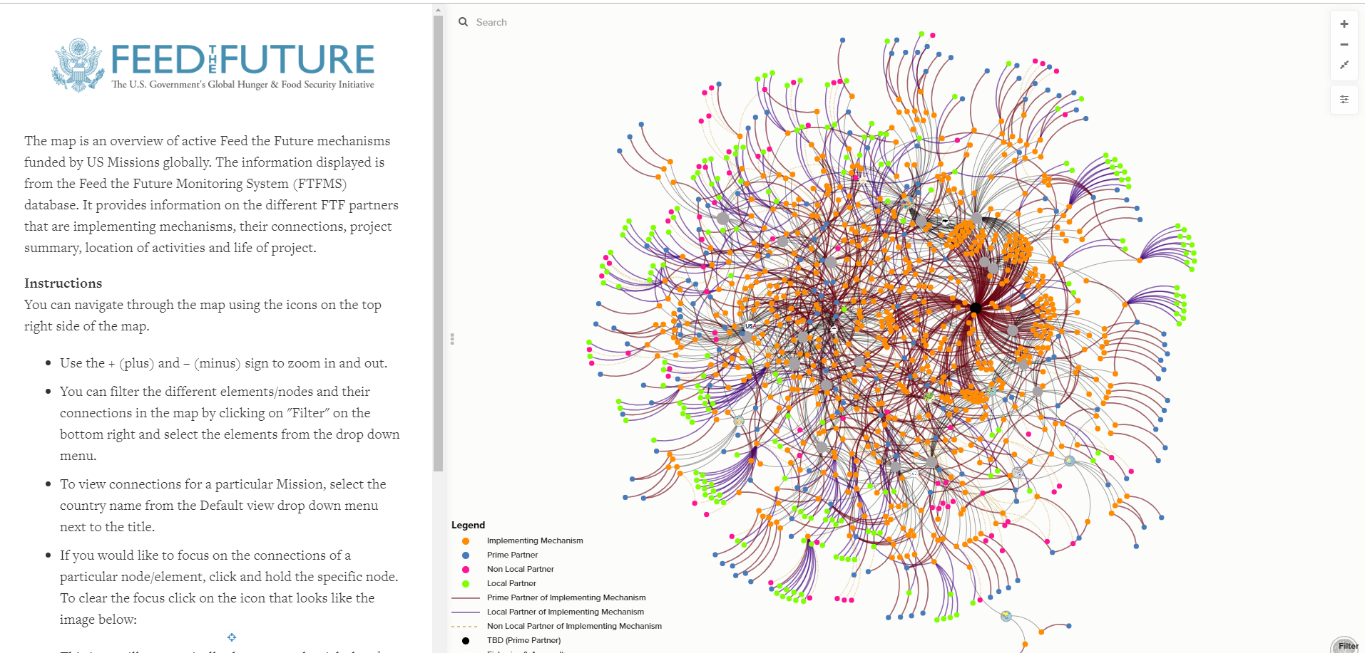
Working across the “three Ds” of foreign affairs; Defense, Diplomacy and Development, QED helps their clients collect, analyze, visualize, and ultimately use data in more effective ways.

Slide 5

Data, Technology and Innovation

Slide 6
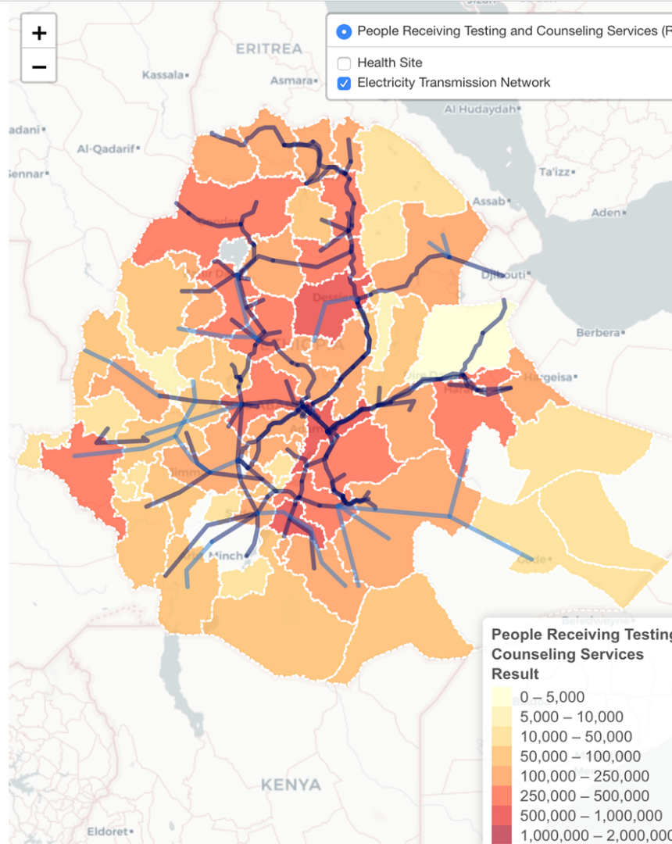
QED offers: • Human-centered design • Data analysis • Data visualization • Network mapping • Infographics

Slide 7


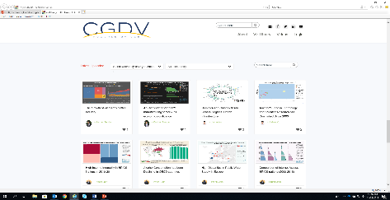
CENTER FOR GLOBAL DATA VISUALIZATION
Designed to build data visualization capacity and strengthen a culture of data use in international development
Mobilizes the power of university students to close the gap in data visualization
Collaborating universities will have access to trainings and can publish research on the CGDV platform

Slide 8
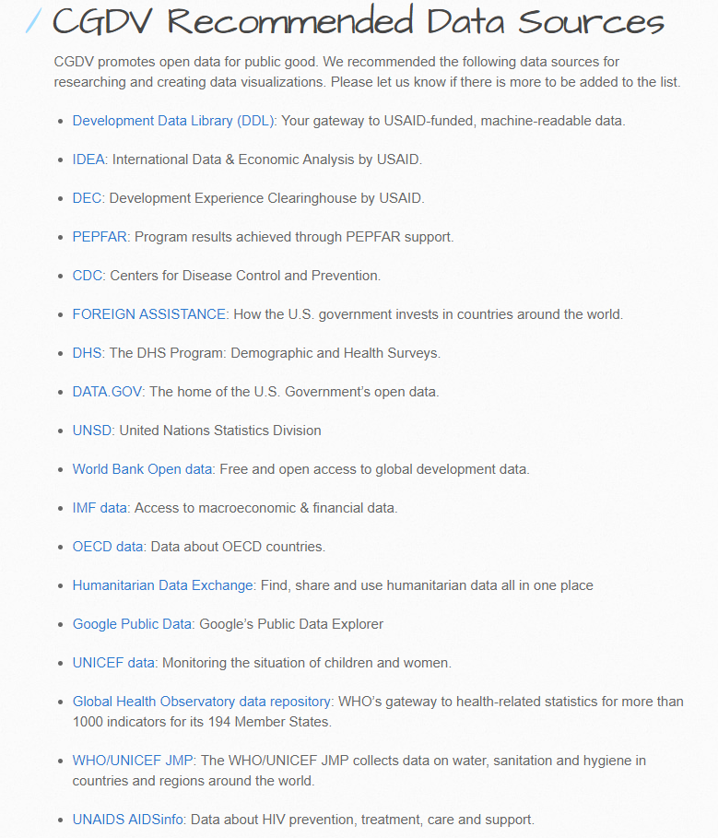
CENTER FOR GLOBAL DATA VISUALIZATION
Visit our GitHub and find out public available data source
https://cgdv.github.io/dataSource/

Slide 9
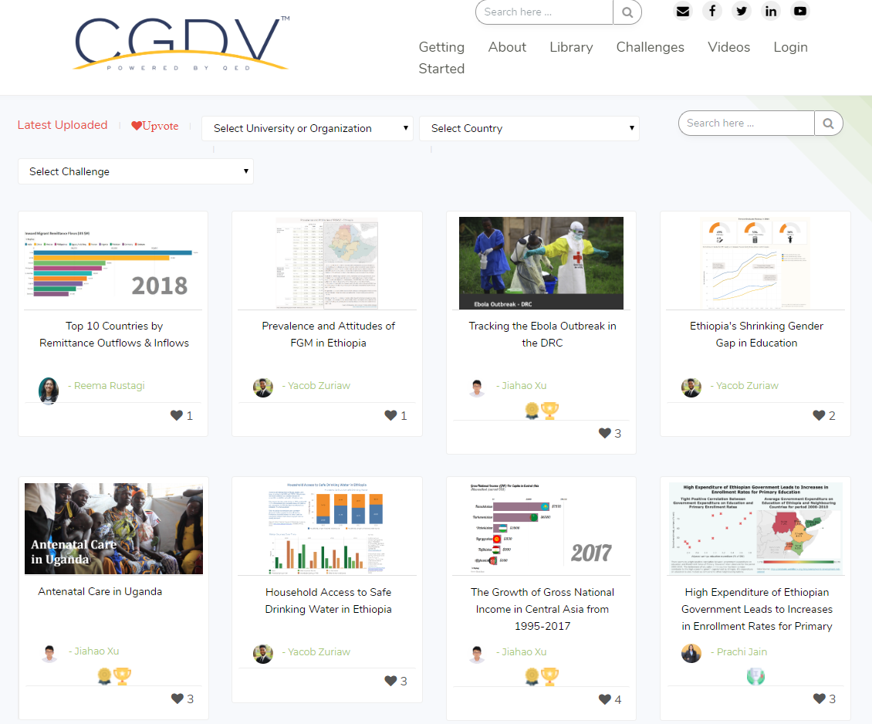

Slide 10

CENTER FOR GLOBAL DATA VISUALIZATION – User Profiles
https://www.centerforglobaldata.org/
Sign up for an account
Create your own profile!

Slide 11
What is Tableau?

Slide 12

What is Tableau?
Tableau Desktop is a business intelligence and data visualization tool that can be used by anyone.
It specializes in transforming tabulated data into eye-candy graphs and representations.
Although designed with business in mind, it’s ability to interactively visualize data freely transcends fields

Slide 13

What is Tableau?

Slide 14

Tableau vs. Excel
People are often confused between Tableau and Microsoft Excel. Both these tools can be used to create interactive visualizations and have the tools to analyze data. But the approach each of these tools uses to reach the insights is very different.
Tableau is a data visualization tool, meaning that it formats data in the initial stage into pictorial representations. When users drill down the data, the representations change accordingly. Excel, on the other hand, needs the user to first analyze data in tabular format and then opt for visualizations for better understanding and insights.

Slide 15
Tableau Installation

Slide 16

Tableau Installation
Tableau Academic Program:
www.tableau.com/academic/students

Slide 17
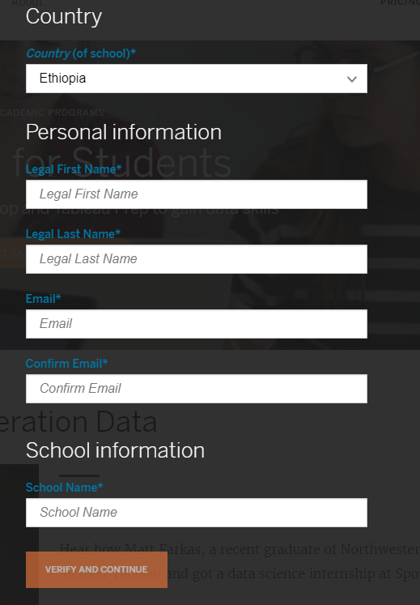
Verify Your Student Identity
You will receive an email from Tableau with instruction of how to download and activate Tableau

Slide 18
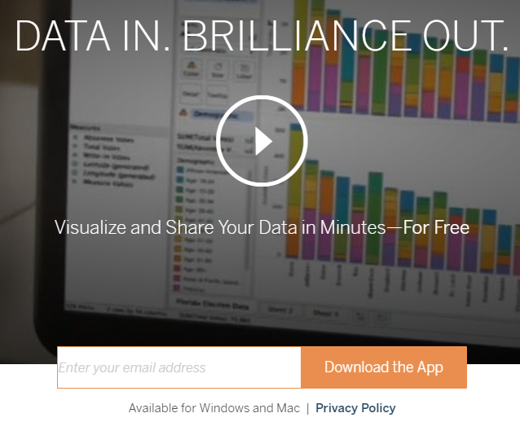
Tableau for Public
Tableau Public: public.tableau.com
Enter
your
Email

Slide 19

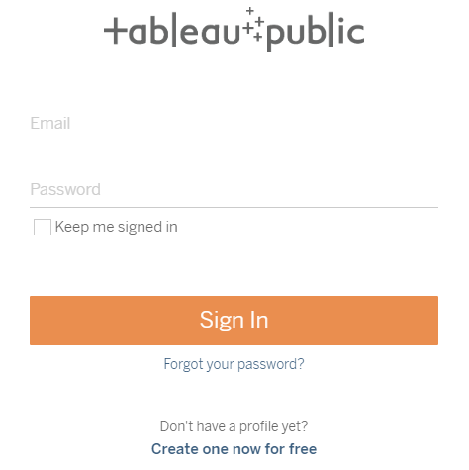
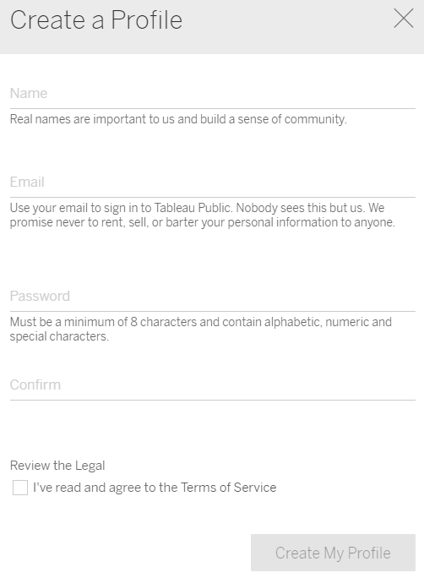
Create Tableau Public Profile to Share Your Work
Tableau Public: public.tableau.com
Right upper corner:
Create profile
Create

Slide 20
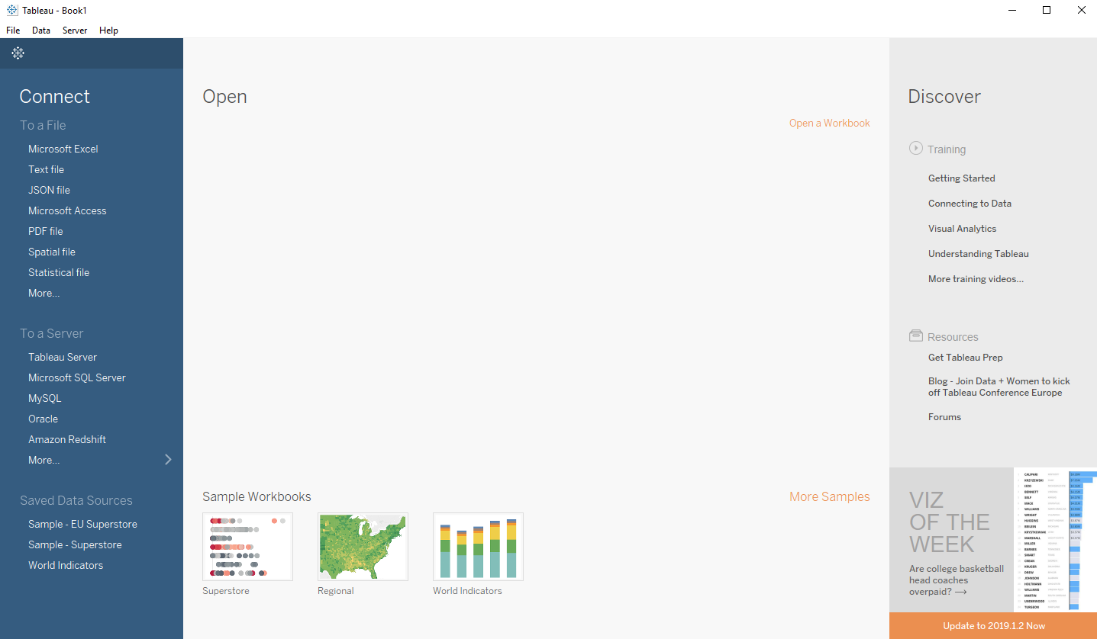
Open Tableau!
If you see above picture, you are ready to go!

Slide 21
Build Your Own Data Visualization in Tableau
Ethiopia HIV Prevalence

Slide 22
Data
- Understand data and make data useful
Today:
- Data cleaning
Visualize
- Choose the right visualization format
Today:
- Line chart
- Choropleth map
- Dashboard
Share
- Share your work for public good
Tomorrow:
- Publish to Tableau public
- Share on CGDV

Slide 23

About the Data
HIV Prevalence in Ethiopia from 1992 to 2017
Population: Adult Age 15 - 49
Data source: UNAIDS
aidsinfo.unaids.org
Example data: https://github.com/CGDV/CGDV.github.io/tree/master/workshop/Tableau/data

Slide 24
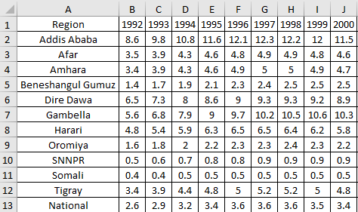
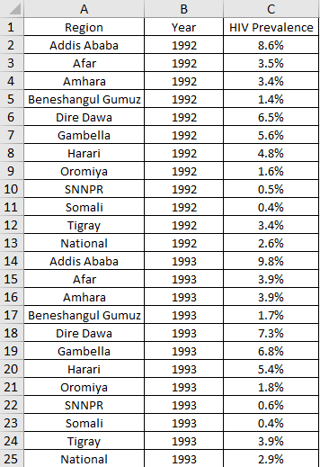
Data Cleaning
Tidy Data (by Hadley Wickham)
Each variable is stored in its own column
Each observation is stored in its own row
Why Tidy Data?
Easy to access variables
Automatically preserves observations
Data is quickly excluded during filtering

Slide 25
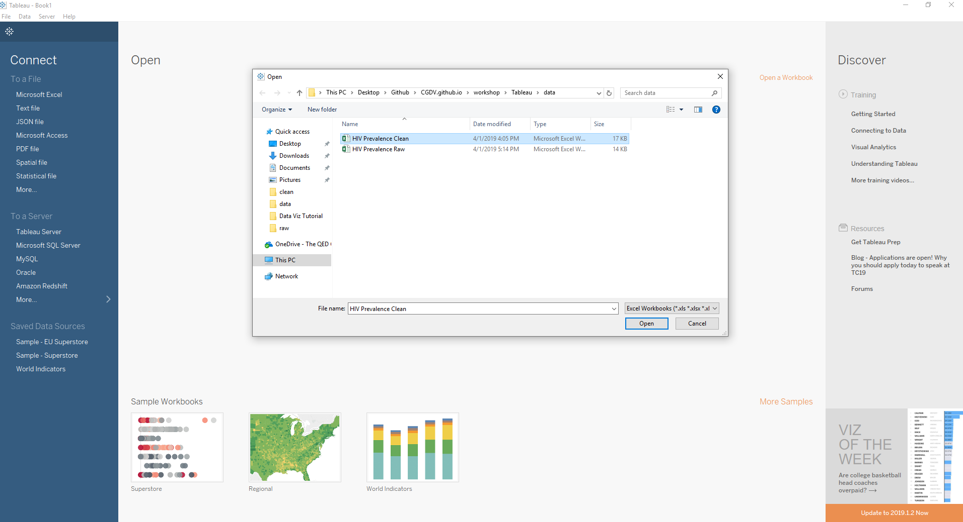


Import Data to Tableau

Slide 26
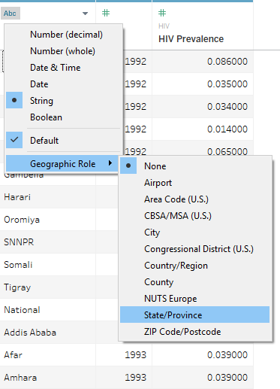
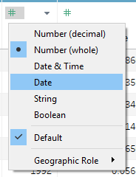
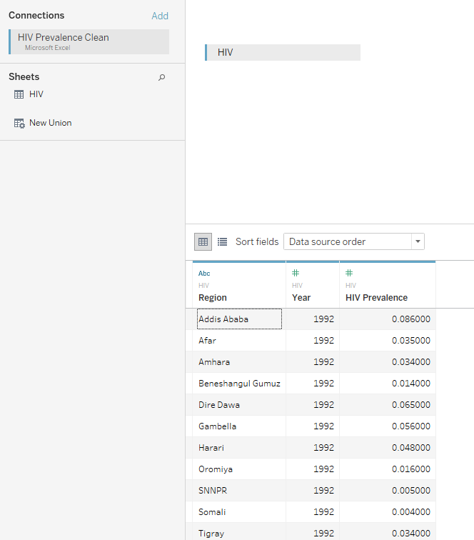

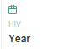
Choose Right Data Type
Region
Year

Slide 27
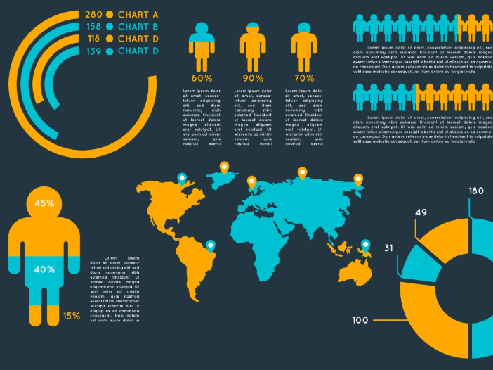
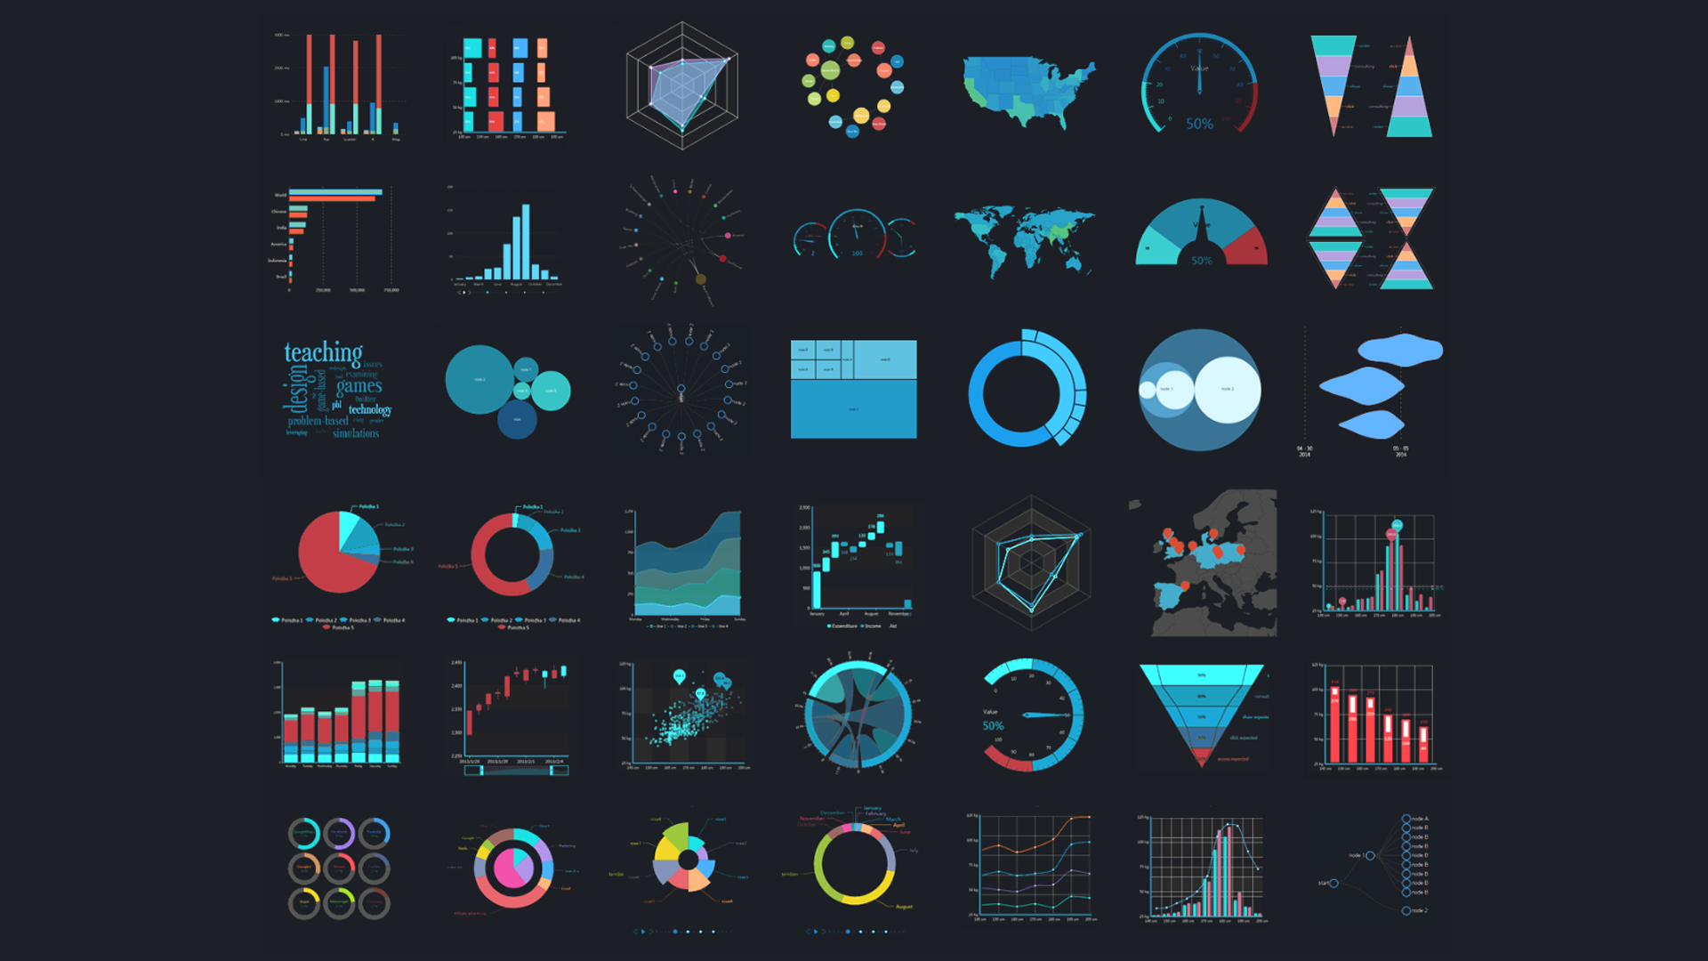
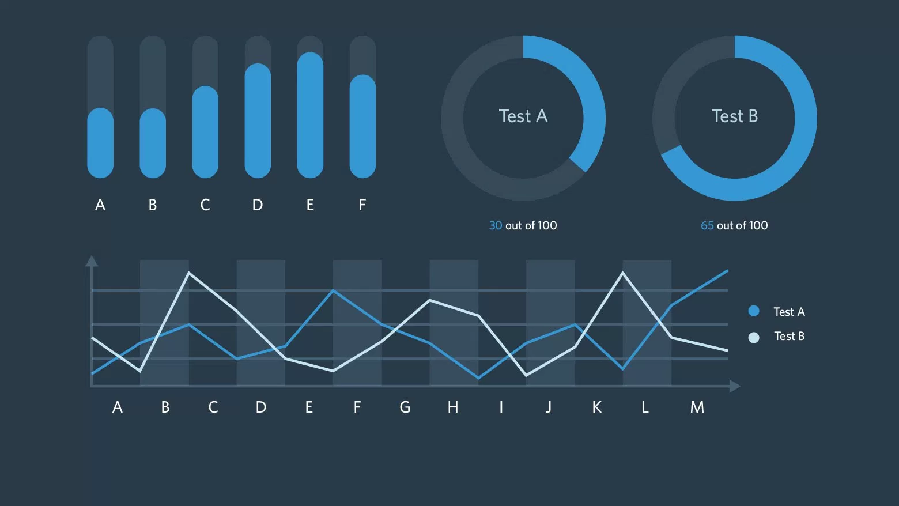
Let’s Visualize Data!

Slide 28

Tableau 101
Sheet < Dashboard < Story
Sheet: Single visualization
Dashboard: Multiple sheets
Story: Multiple sheets + dashborads
Notes:
At the bottom of your screen you’ll see the sheets tabs.
Click Sheet 1

Slide 29
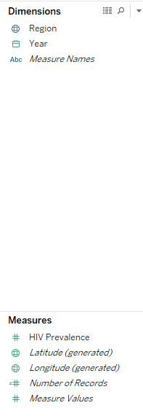
Tableau 101 Dimensions vs Measures
Dimensions:
- Level of detail
- How to want to separate data?
(location, date…)
Measures
- Aggregation
- How to want to calculate data?
(Average, count, …)

Slide 30
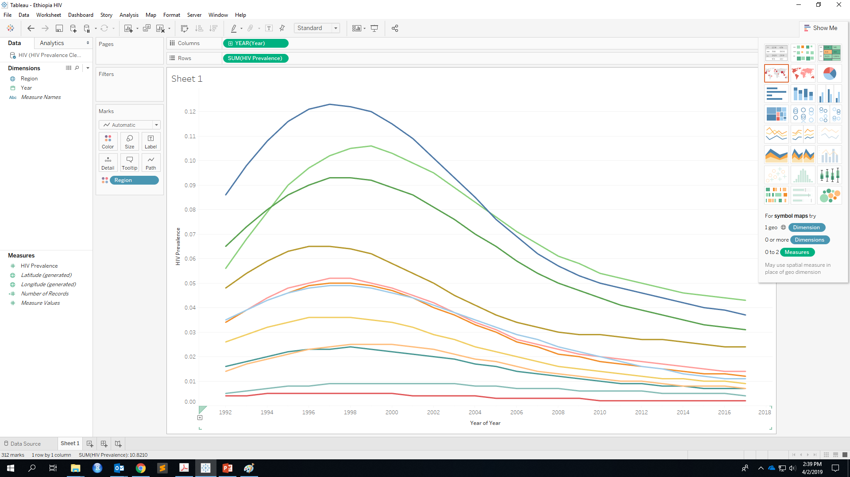

Line Chart
Drag!

Slide 31
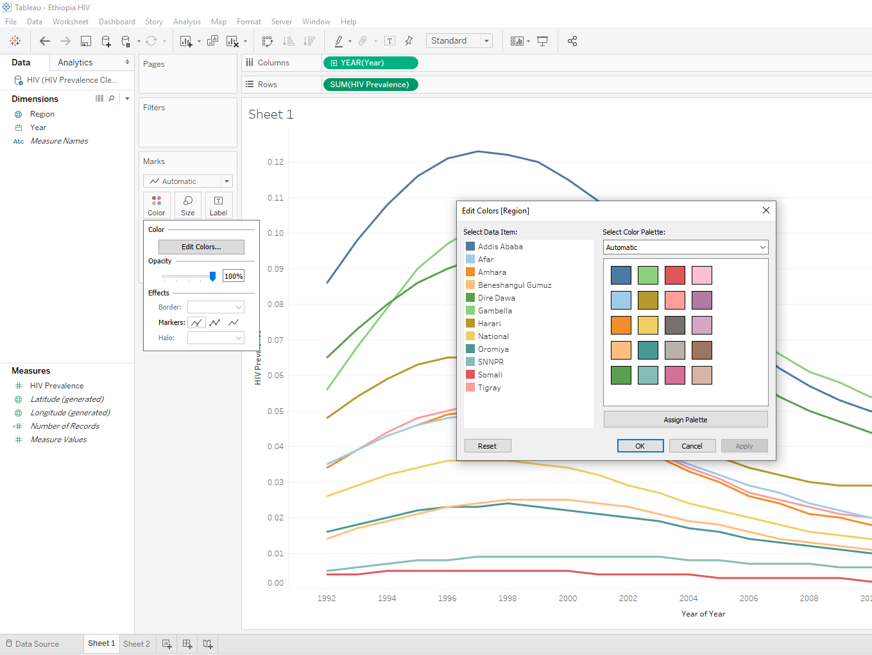
Customize Color
Customize line color

Slide 32
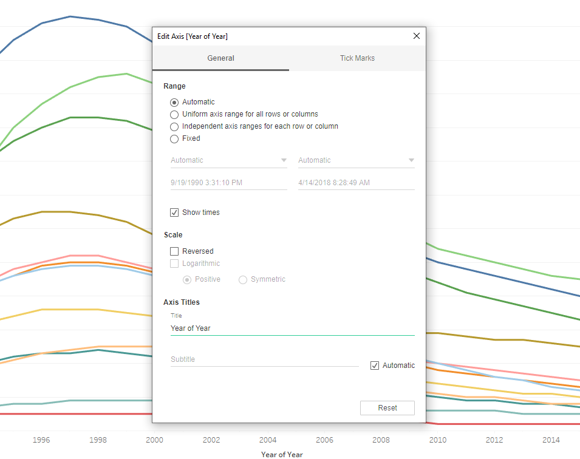

Customize Axis
Double click to edit axis

Slide 33
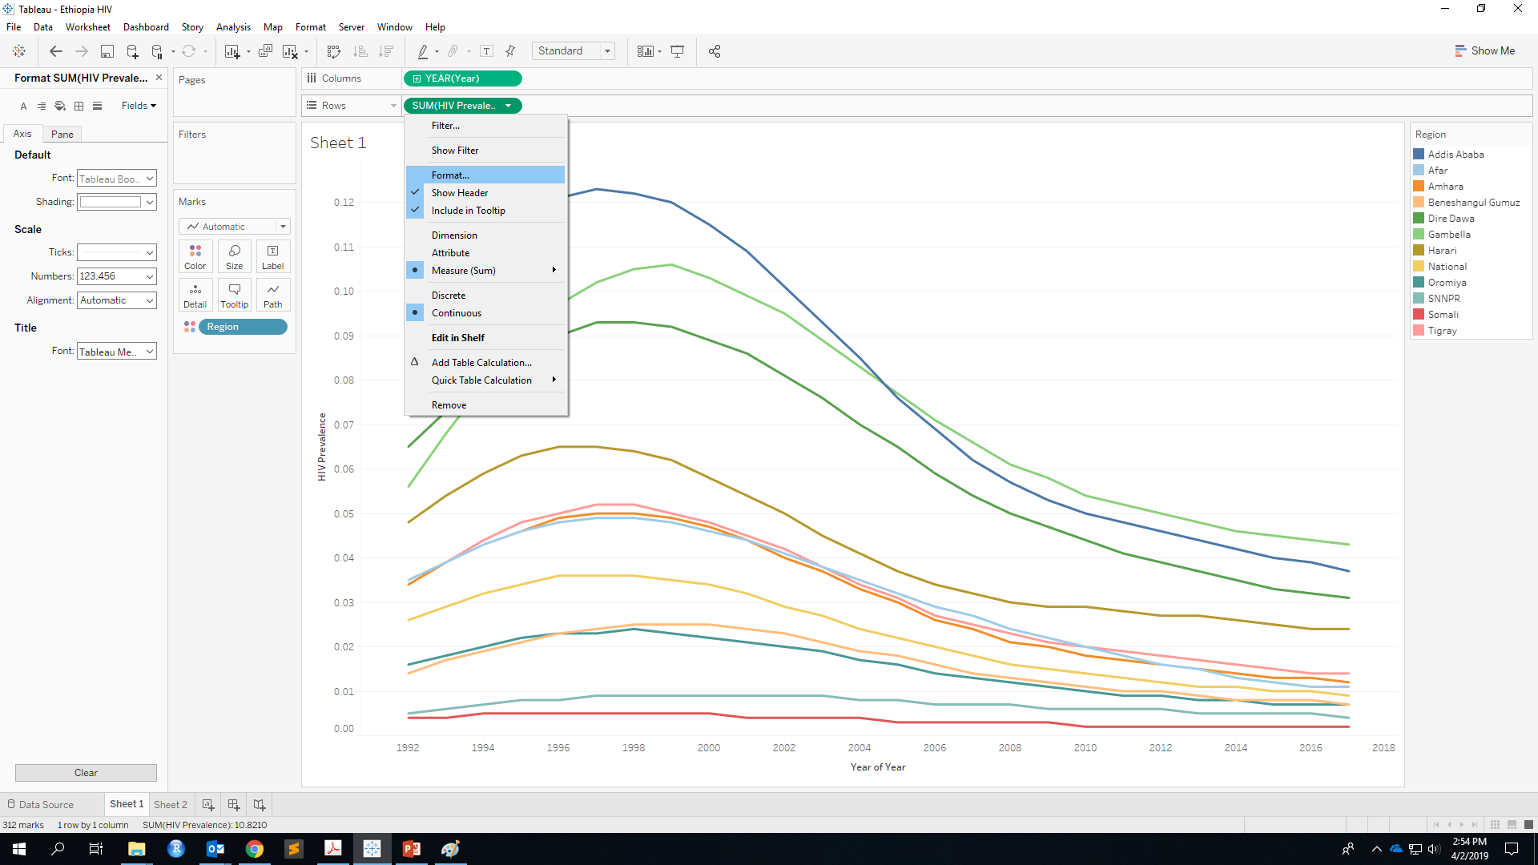
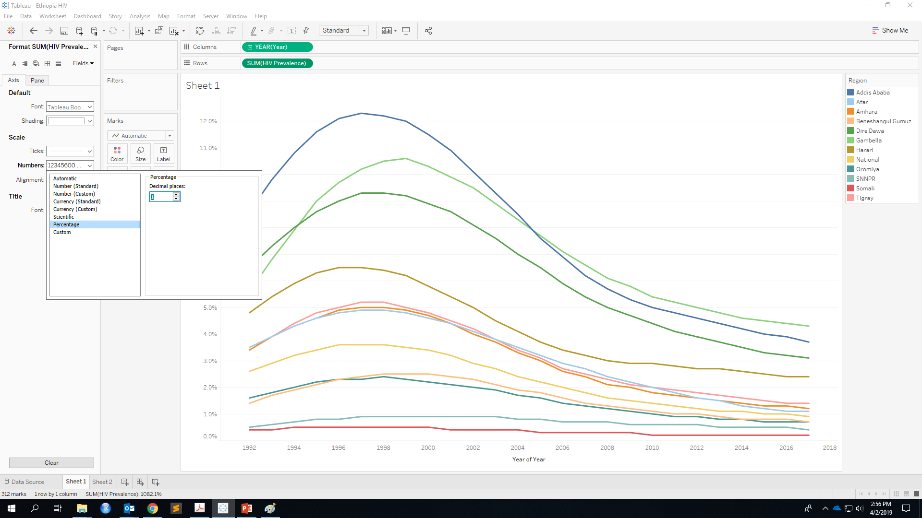
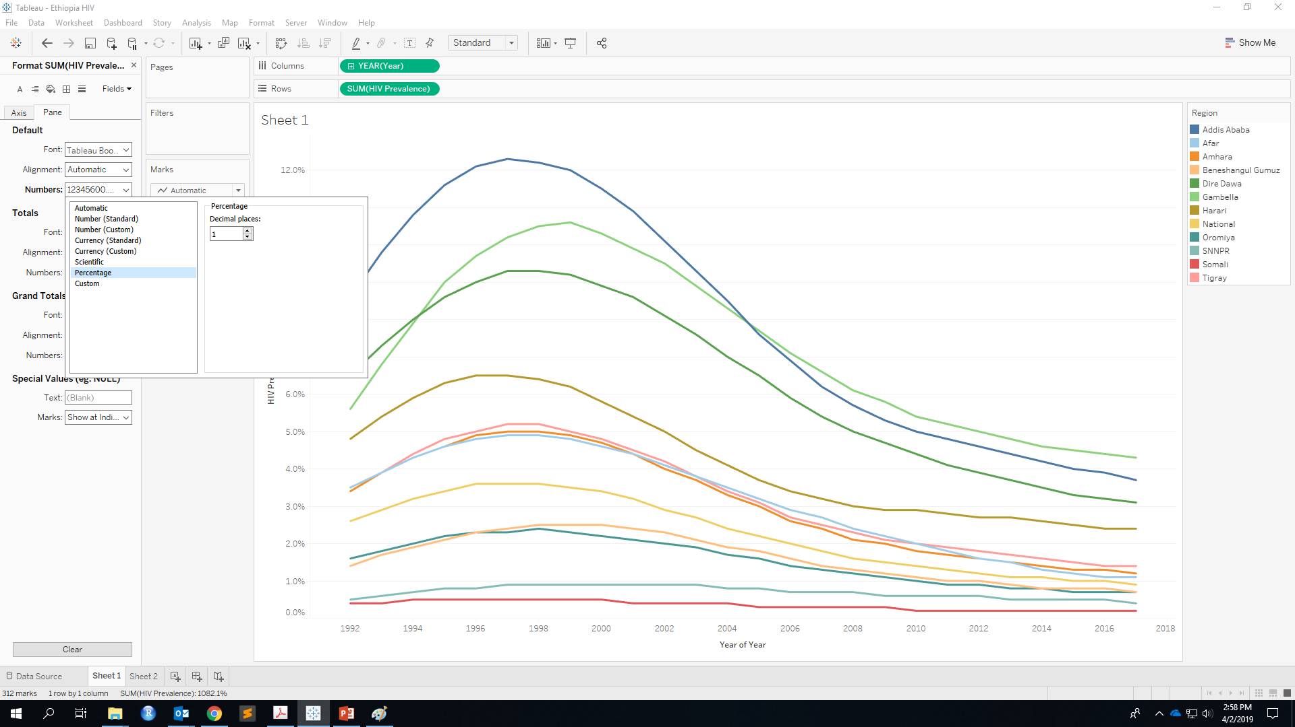
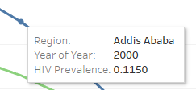
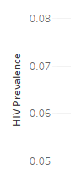
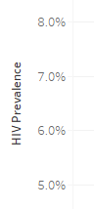
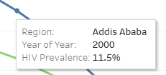
Show as Percentage

Slide 34
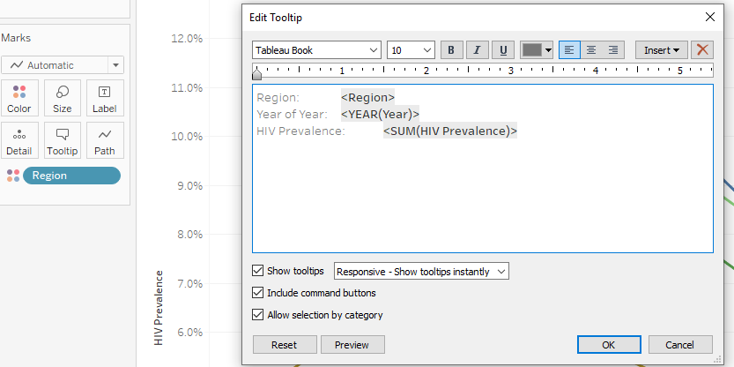
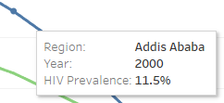
Customize Tooltip

Slide 35
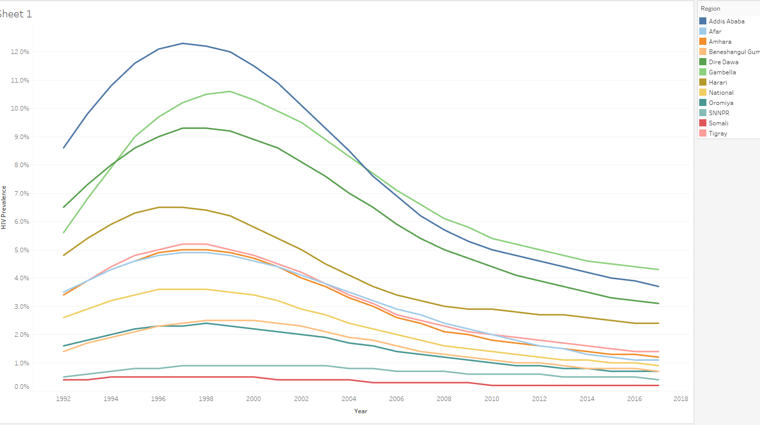
Line Chart Done!

Slide 36
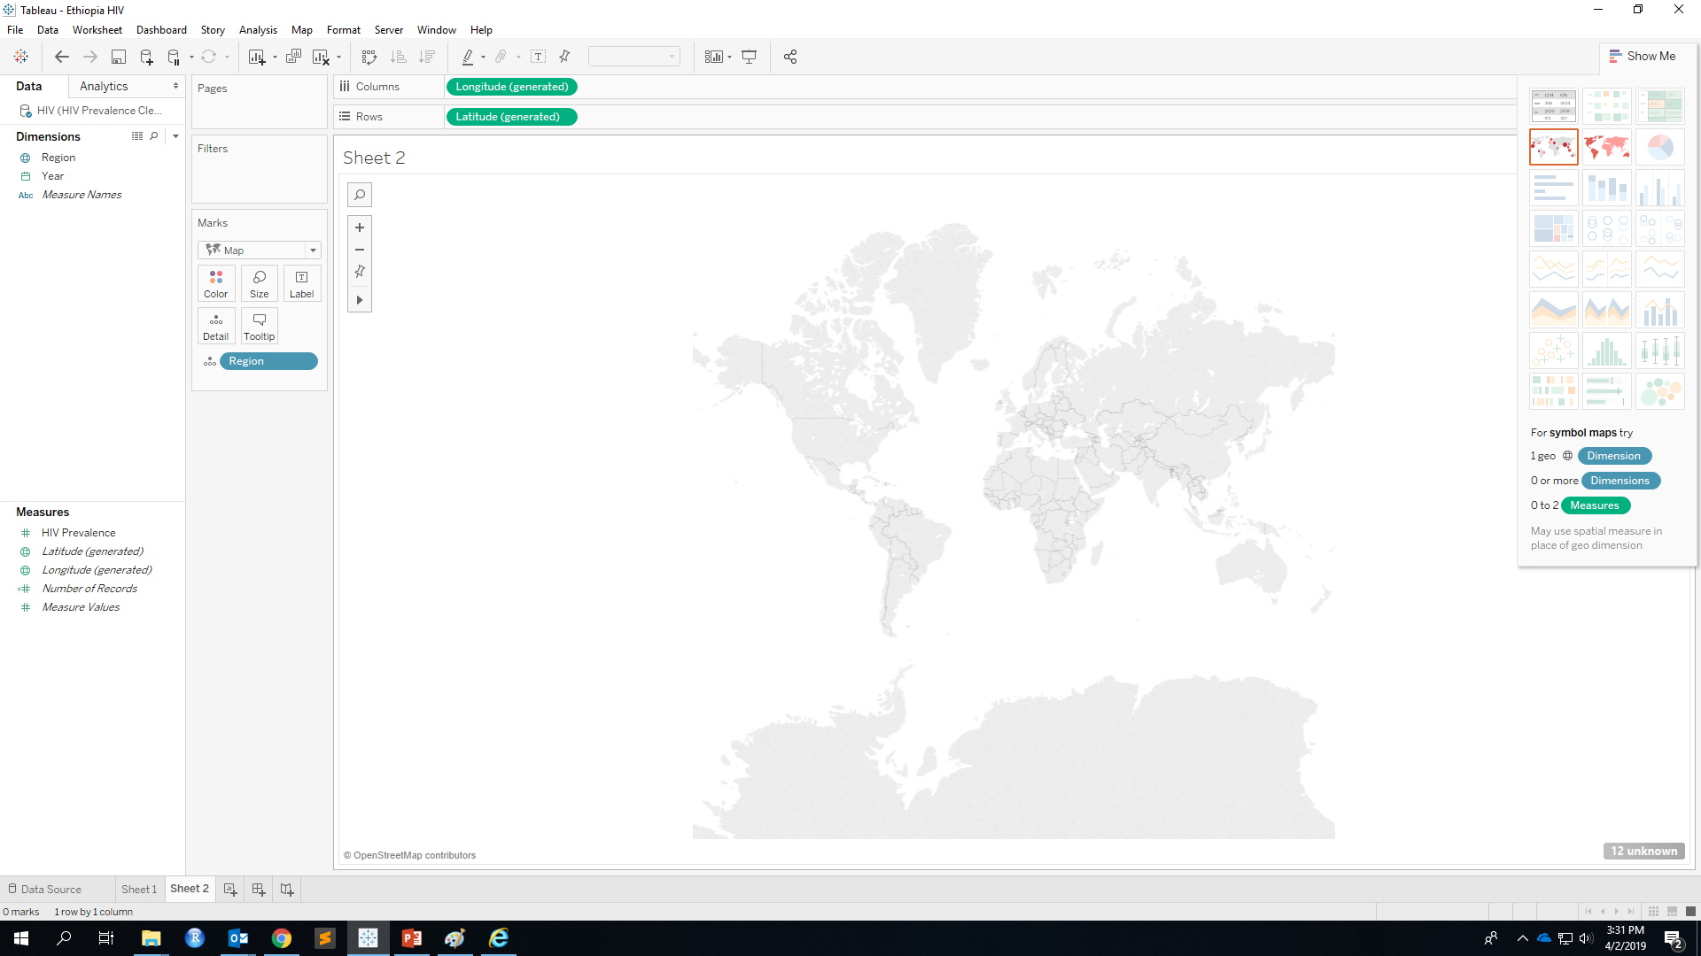
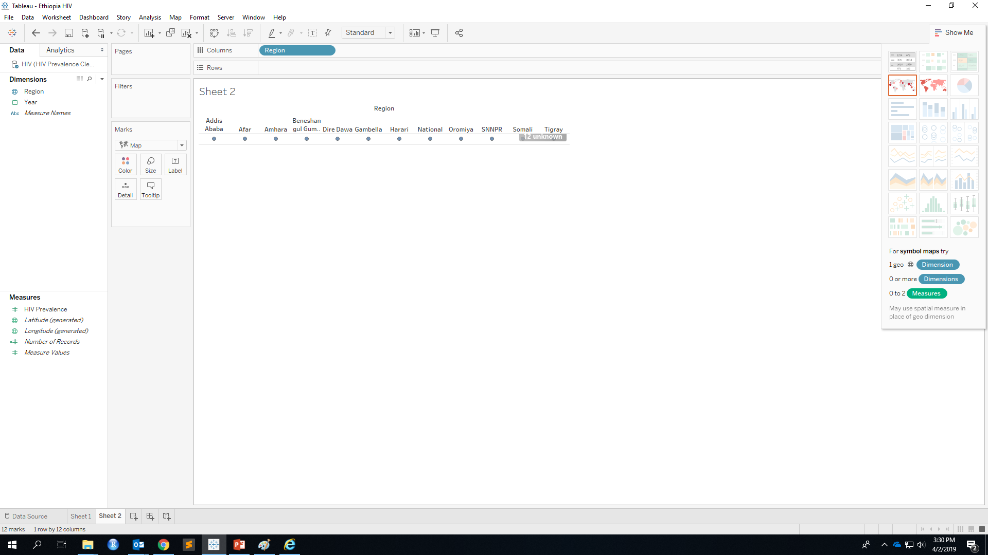
Choropleth Map

Slide 37

Match Location
Why nothing on the map?
We have unknown geographic locations!

Slide 38
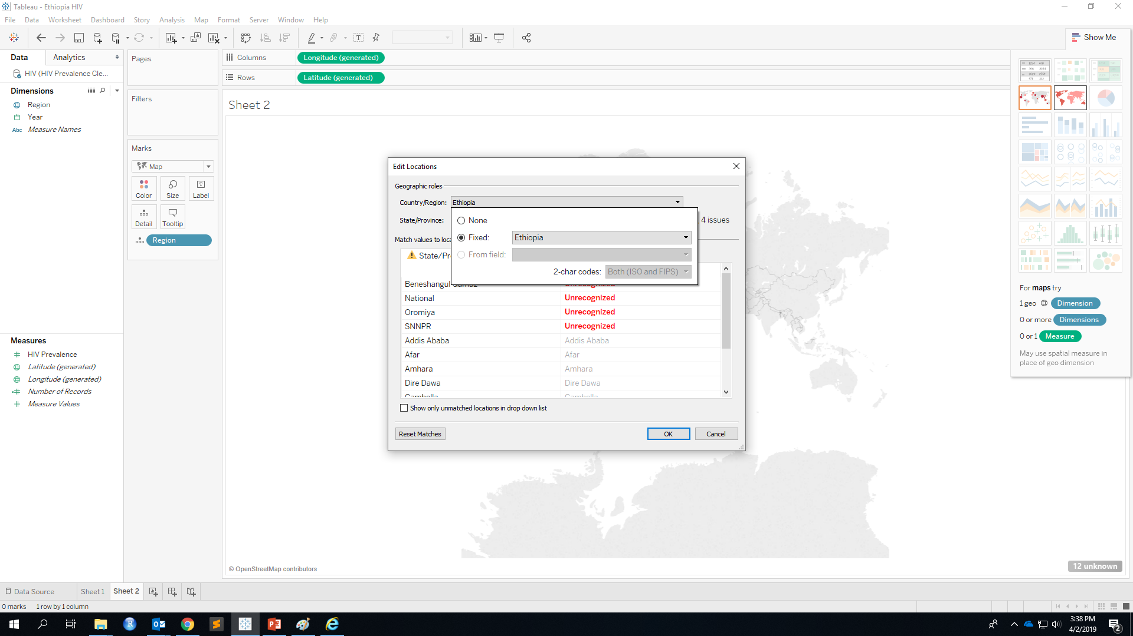
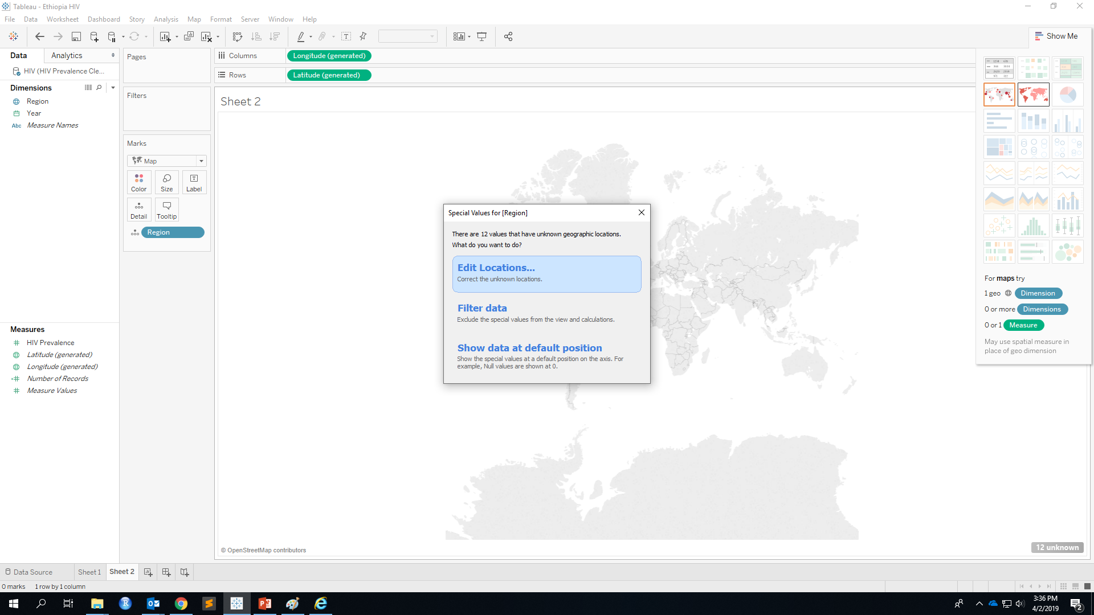
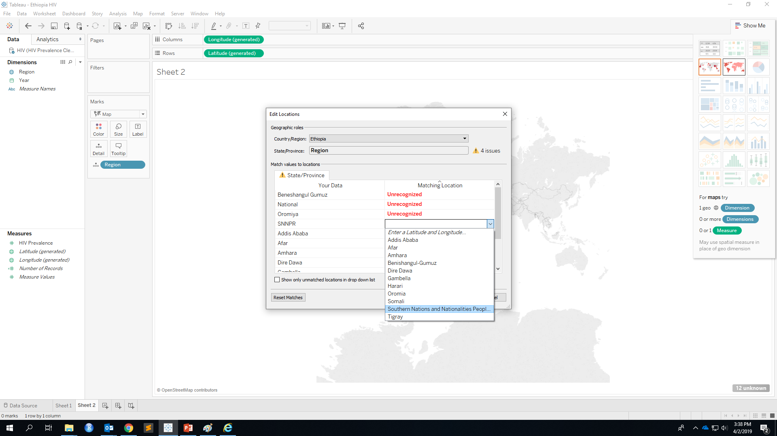
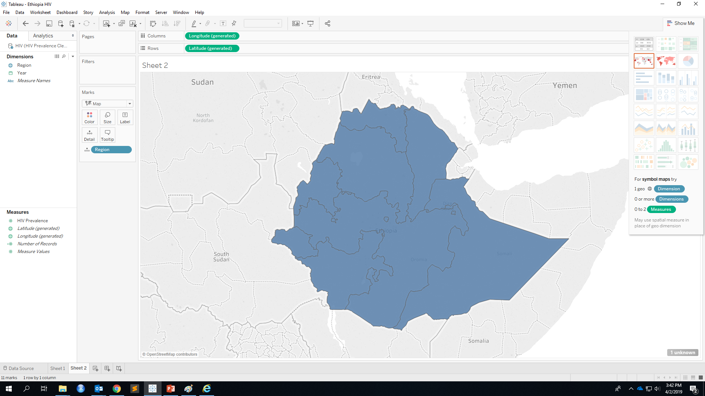
Edit Locations
Select Country
Match Unrecognized
Region

Slide 39
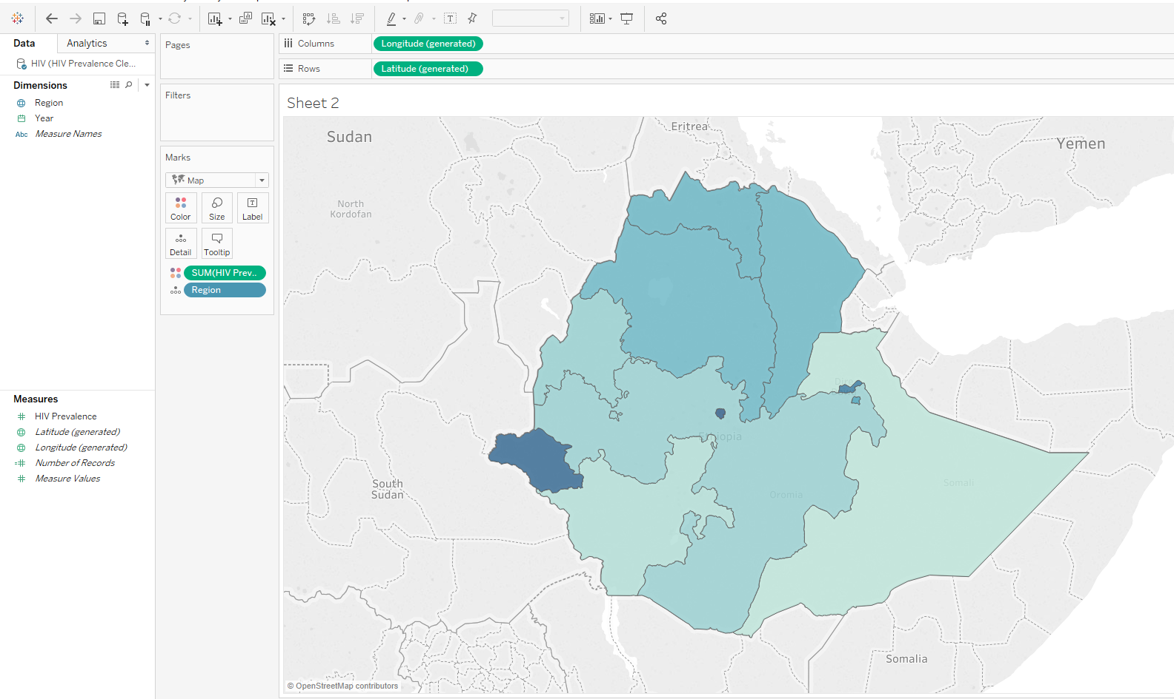
Color
Drag HIV Prevalence to Color
Color here shows sum of prevalence over past 25 years, NOT what we want!!!!
Notes:
We have now tied the Region variable’s data to geographic spaces.

Slide 40
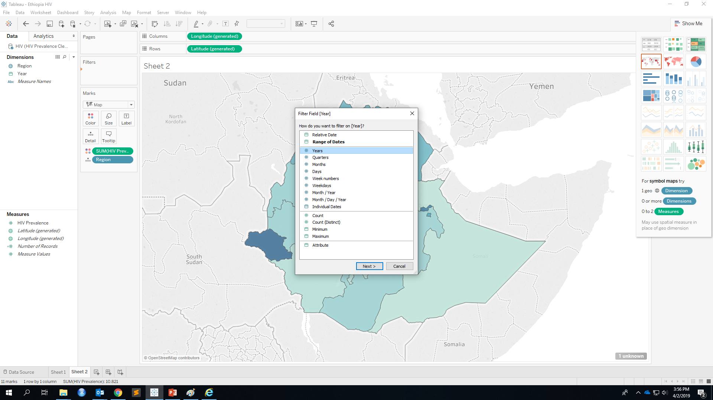
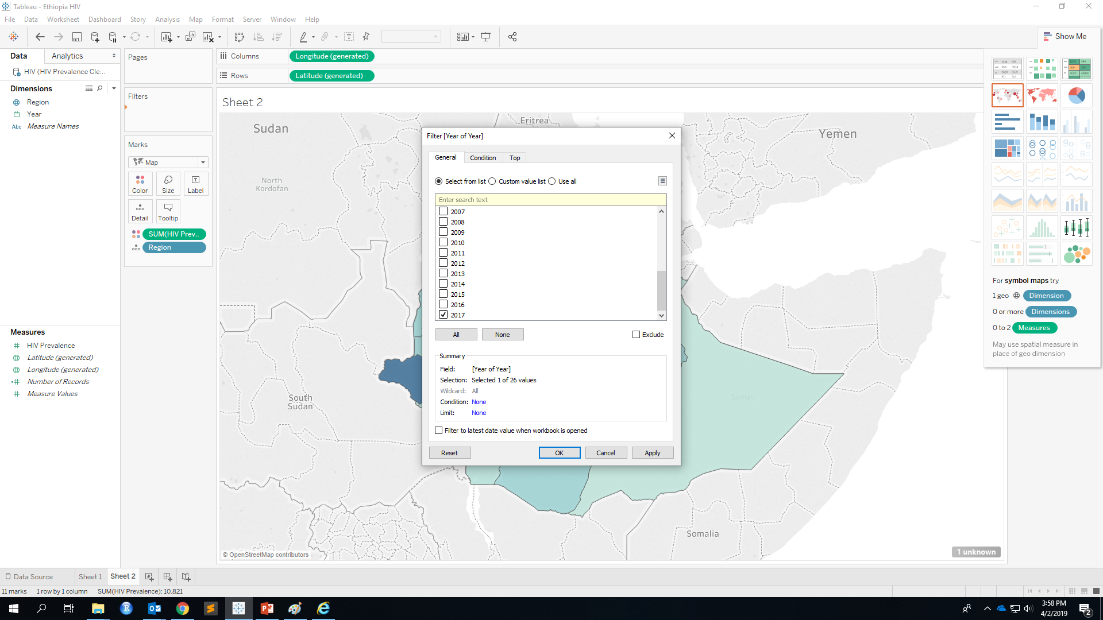
Filter by Year
Choose single year you want to visualize
Drag Year to Filter

Slide 41
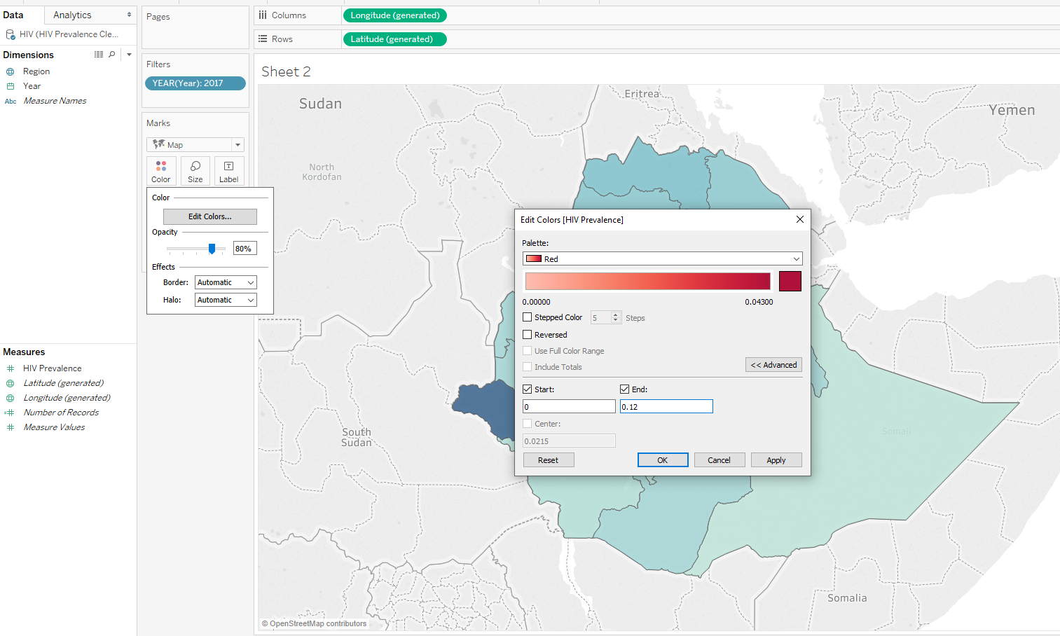
Customize Color
Choose Palette
In Advanced, fix value range

Slide 42
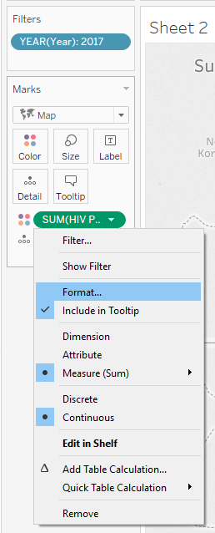
Show as Percentage

Slide 43
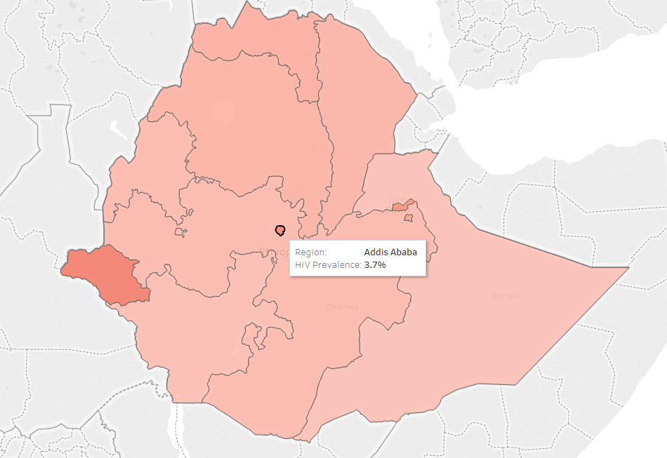
Choropleth Map Done!

Slide 44
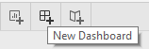
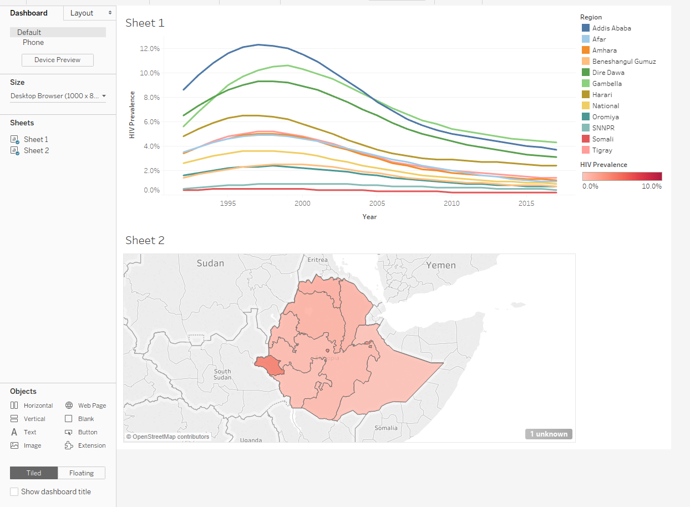
Dashboard
Create a new dashboard tab
Drag both sheets to dashboard

Slide 45
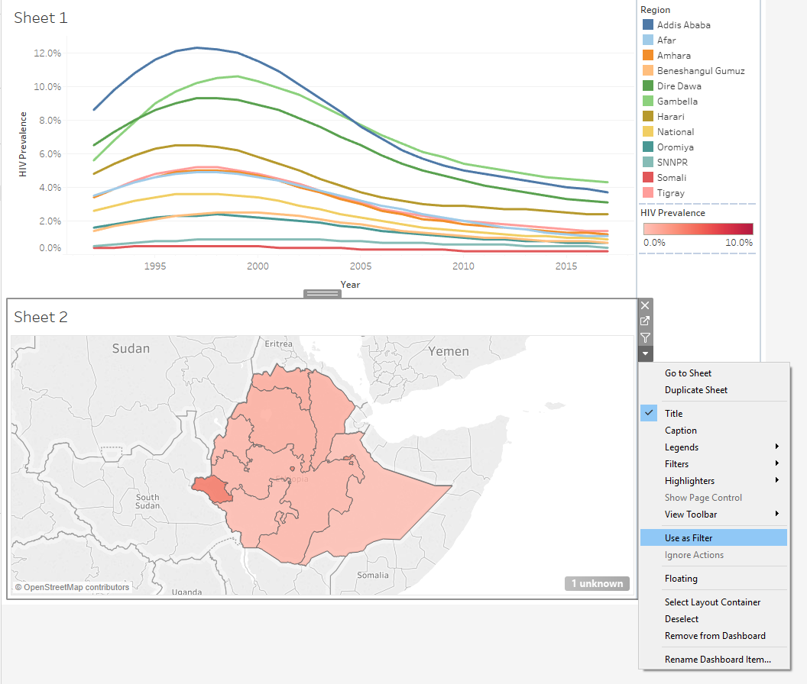
Connect Chart
More options
Use as Filter
Now when you click on a region, the first chart also change!

Slide 46
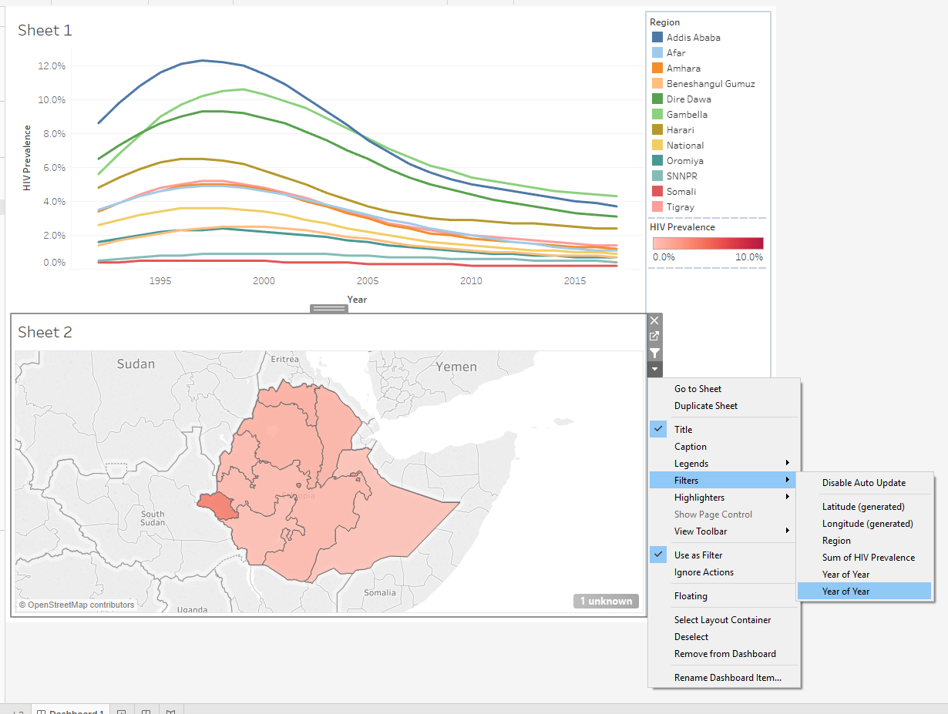

Add Time Slider
More options
Filters
Year of Year
Add year filter

Slide 47


Add Time Slider
More options
Customize
Uncheck Show “All” Value
More options
Single Value (slider)

Slide 48

Customize Content
Change dashboard background color
Format -> Dashboard -> Dashboard Shading

Slide 49

Customize Content
Modify Title by double clicking on the title
Add object (text, image) by dragging object to dashboard

Slide 50
Customize Content
How to add YouTube video?
Drag a Webpage in to dashboard
Enter your modified YouTube link
Before
https://www.youtube.com/watch?v=Mg43RbYsBho
Keep ID and add “/embed/”
After
https://www.youtube.com/embed/Mg43RbYsBho

Slide 51

Dashboard Done!

Slide 52

Share Your Tableau Work (Tableau Desktop Only)
Extract data:
Data
HIV
Extract Data

Slide 53


Share Your Tableau Work (Tableau Desktop Only)
Extract data:

Slide 54


Share Your Tableau Work (Tableau Desktop Only)
Publish:
Server
Tableau Public
Save to Tableau Public
Sign in your Tableau Public Account

Slide 55

Share Your Tableau Work (Tableau Public Only)
Easy two steps!
1. “File” on the top
2. Save to Tableau Public

Slide 56

Your Work is Public!

Slide 57



Share Your Tableau Work on CGDV
Find share button under your Tableau visual
Copy the Embed code when uploading visual on CGDV.

Slide 58
End of Module 1

